Slide 1


Recommendation System​​
A recommendation system (or recommender system) is a class of machine learning that uses data to help predict, narrow down, and find what people are looking for among an exponentially growing number of options.
In simple words, it is an algorithm that suggests relevant items to users. Eg: In the case of Netflix which movie to watch, In the case of e-commerce which product to buy, or In the case of kindle which book to read, etc.
by Sonu Sarojini

Slide 2

Understanding the Fundamentals of Recommendation Systems
1
User Preferences
2
Item Features
3
Algorithms
Recommendation systems start by understanding user preferences, whether explicit (ratings, reviews) or implicit (browsing history, purchase data). This information is critical for generating tailored recommendations.
This involves analyzing attributes like genre, content, and user engagement data to accurately match items to users.
Recommendation systems employ diverse algorithms like collaborative filtering, content-based filtering, and hybrid approaches to generate relevant suggestions.

Slide 3
Types of Recommendation Systems
Content-Based Filtering
Collaborative Filtering
Hybrid Approach
This approach recommends items similar to those a user has interacted with in the past. It analyzes the content of items and user preferences based on those attributes.
This method leverages user similarity. It recommends items based on the preferences of other users who share similar tastes, even if they haven't interacted with the same items before.
A combination of content-based and collaborative filtering, this method leverages strengths from both to provide more robust and personalized recommendations.
Eg: if a user enjoys action movies, the system will suggest other action films based on their characteristics, such as genre, director, or cast.
Eg: If many users who liked "The Dark Knight" also enjoyed "Inception," then the system might recommend "Inception" to someone who enjoyed "The Dark Knight," assuming they have similar tastes based on their ratings of other films.
Eg:A music streaming service uses content-based filtering to recommend tracks similar to those you’ve previously enjoyed based on attributes like genre, artist, and tempo. Simultaneously, it employs collaborative filtering by analyzing users with similar listening habits.

Slide 4
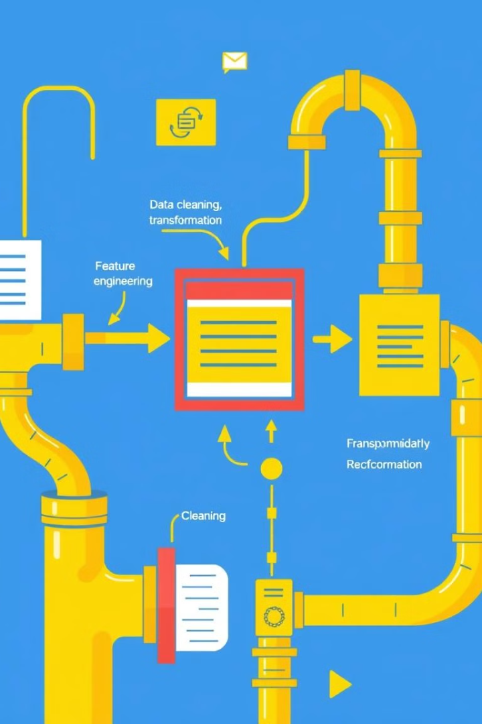
Data Preprocessing and Feature Engineering for Recommendation Systems
1
Data Collection
This step involves gathering user interaction data, item features, and contextual information relevant to the recommendation system.
2
Data Cleaning
Handling missing values, removing duplicates, and addressing inconsistencies ensure data quality for accurate analysis and model training.
3
Feature Engineering
This involves creating new features from existing data, such as user demographics or item popularity, to provide richer insights for the recommendation engine.
4
Data Transformation
Transforming data into a suitable format for modeling, such as normalization or standardization, ensures efficient and accurate model performance.

Slide 5

Example: Music Recommendation System (YouTube Music)
CASE STUDY
System Overview:
Youtube’s recommendation system must deal with three key components that differentiate it from other online recommendation systems. First of all, Youtube’s massive user base and corpus, many existing and well-functioning recommendation systems fail to work on the scale of YouTube. Additionally, with hours worth of content being uploaded by the second, YouTube’s recommendations must be responsive enough to incorporate newly uploaded content. Lastly, the ‘noise’, or meaningless data, that comes from sparsity and a variety of unobservable factors make it incredibly difficult to predict user behavior.
To combat these challenges, Youtube’s recommendation system is made up of two separate neural networks:
1.Candidate generation
2.Ranking system

Slide 6
TECHNIQUES USED
1.CANDIDATE GENERATION
the Candidate Generation system is responsible for turning “the enormous YouTube corpus” (2) into a couple of hundred relevant videos. The model used to make this selection is trained with millions of separate classes and uses a technique called candidate sampling, which the authors claim to be 100 times faster than traditional methods, without sacrificing accuracy.
An advantage the deep neural network has is the ability to easily add continuous and categorical features into the model. For instance, a user’s recent search history is immediately incorporated into the selection process. Each search query unigrams and bigrams (sequence of one(uni) word or two(bi) consecutive words) are tokenized and treated as a feature to find new videos.

Slide 7
2.RANKING
After a neural network narrows down the vast number of YouTube videos to a few hundred possibilities, another neural network ranks these videos to determine which ones are most likely to interest a specific user. This ranking process can incorporate more detailed features than the initial narrowing-down process, as it's working with a much smaller set of videos.
The features used in ranking are roughly split between categorical and continuous, with categorical features being embedded and continuous features normalized.

Slide 8
In the end, the score of the videos that go through ranking is primarily based on the predicted expected watch time. Watch time is a good indicator of engagement since it punishes videos that intentionally deceive users into clicking on for the sole purpose of gaining views (known as clickbait). The technique of weighted logistic regression is used to predict expected watch time.

Slide 9
Collaborative Filtering
Collaborative filtering is a technique used by YouTube's recommendation system to analyze user behavior and preferences. By identifying users with similar viewing habits, the system can recommend videos that those similar users have enjoyed. For example, if a user frequently watches gaming videos, the system might suggest other gaming channels or specific videos that users with similar preferences have watched and liked.
Content-Based Filtering
Content-based filtering, on the other hand, focuses on the characteristics of the videos themselves. By analyzing the video's metadata, such as title, description, tags, and visual content, the system can recommend videos that are similar to what the user has watched in the past. If a user frequently watches cooking tutorials, the system might suggest other cooking tutorials, or videos on related topics like food reviews or restaurant recommendations.

Slide 10
Impact of the Recommendation System
YouTube Music's recommendation system has had a profound impact on the platform's success:
Increased User Engagement: Personalized recommendations keep users engaged by consistently delivering relevant content.
Enhanced User Experience: By understanding user preferences, the system provides a seamless and tailored listening experience.
Music Discovery: The system helps users discover new artists and genres, expanding their musical horizons.
Revenue Generation: Effective recommendations drive user retention and premium subscriptions, contributing to YouTube Music's revenue growth.

Slide 11
Conclusion
YouTube Music is a great example of how technology can personalize our experiences. It uses clever algorithms to understand our music tastes and suggest songs we might like. This makes listening to music more enjoyable and helps us discover new artists. As technology improves, YouTube Music will get even better at recommending music tailored to our individual preferences.

